Slide 1
The Bill Clinton Years
Alisa Yanytska, Lauren Fleming, Jessica Pignatelli, and Ku-Ku Tambe

Slide 2
Thesis
Despite a presidential sex scandal and anxiety over domestic terrorism, the Clinton administration remained in public favor by appealing to the moderates of the political spectrum and spearheading the nation through economic boom.

Slide 3
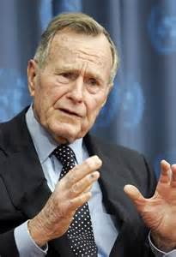
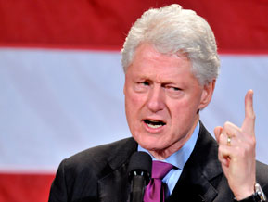
VS.
George H.W. Bush vs. Bill Clinton in the Election of 1992
Republicans cause Recession
Clinton campaigns on promise to reduce deficit and cut taxes for middle class
Bush has no long term solutions

Slide 4
New Democrat In White House
Moderate Democrats
Responded to republican conservative challenge by moving democratic party away from liberal tradition of FDR and Johnson
Hoping to gain white and southern voters
Clinton ran with the agenda of reducing size of federal government and promoting free markets
Failed Health Care Reform
Appointed Hilary Clinton to prepare a middle of the road program for Health care
Failed because overcomplicated and controversial (negative ads)
Help Republicans take over house and the Senate

Slide 5
New Democrat In White House
Newt Gingrich/Contract with America
Conservative Republican house speaker
Proposed Contract with America
Involved large tax cuts
Increase in military spending
Cut backs for federal regulation of environment and work place
Reduction of welfare programs
Tough anti-crime bill
Taken under(took as part of agenda) by Congress and Clinton
Republicans shut down Government
Clinton resumes power

Slide 6
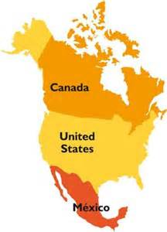
New Democrat In White House
NAFTA (North American Free Trade Agreement)
Signed by Canada, Mexico, United States
Created a more free flow of commerce in North America
Expanded markets and encouraged free trade
Presiding Over the Boom
Reduced government spending
Economic Growth increasing Tax Revenues
Allowed us to climb out of deficit
Citizens invest in technology stocks

Slide 7
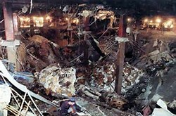
The World Trade Center
Terrorists associated with Bin Laden bomb lower levels of World Trade Center
Clinton took firmer stance on terrorism in the Middle East

Slide 8
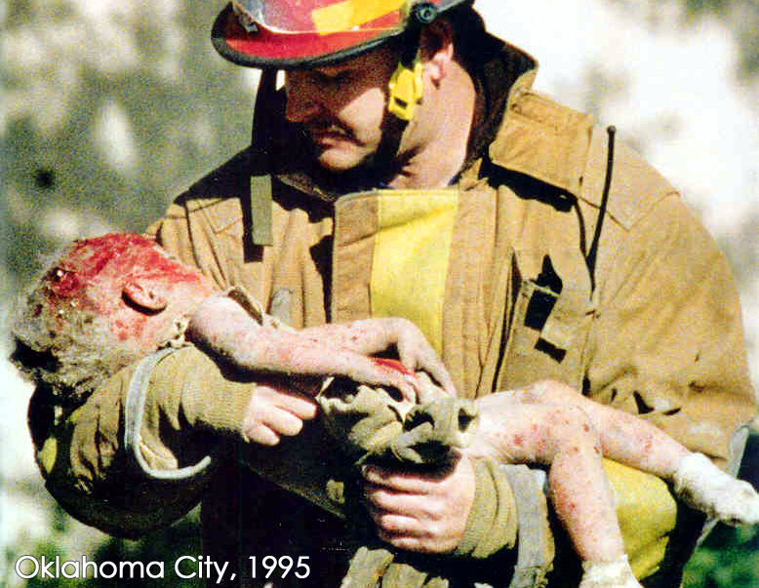
Oklahoma City Bombing
New Right groups such as Branch Davidians
Tried to escape federal government
FBI stormed in on them
Timothy McVeigh bombs Oklahoma City Building in Revenge
168 people killed

Slide 9
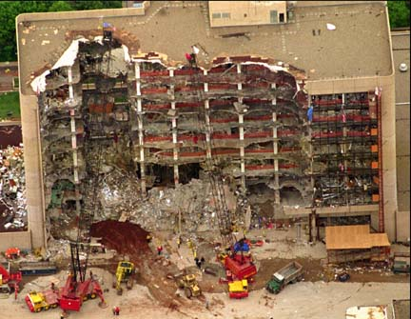

Slide 10
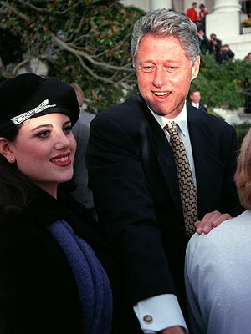
Starr Report
Conservatives higher attorney Kenneth Starr
Starr reports extramarital affair with Monica Lewinsky
Charged Clinton with lying under oath and witness tampering

Slide 11
Impeachment
Trial divided along party lines unlike Nixon
Clinton acquitted in 1999

